Slide 1
Lecture # 7B
20 October 2020
Dr. A. Upadhyaya TA201: Introduction to Manufacturing Processes

Slide 2
Octahedral and Tetrahedral Interstitial Sites
Dr. A. Upadhyaya TA201: Introduction to Manufacturing Processes

Slide 3
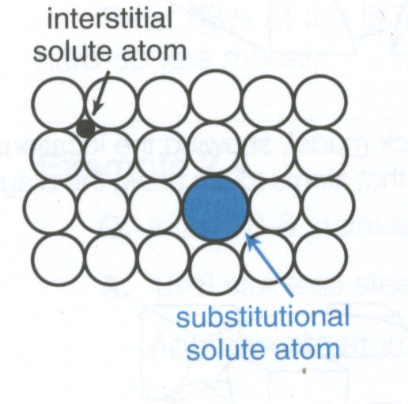
Substitutional and Interstitial Solid-Solution Alloys

Slide 4
To maintain periodicity, in crystals the interstitial solute atoms occupy locations that correspond to tetrahedral or octahedral coordination of parent atoms

Slide 5
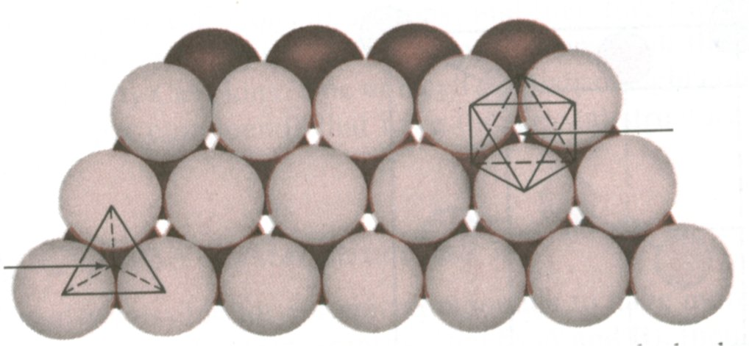
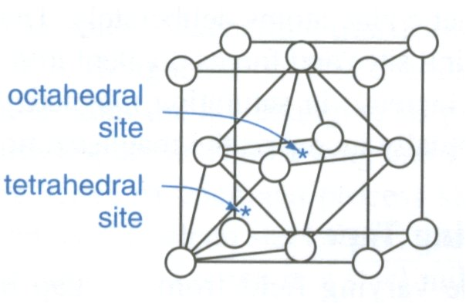
Voids in FCC

Slide 6
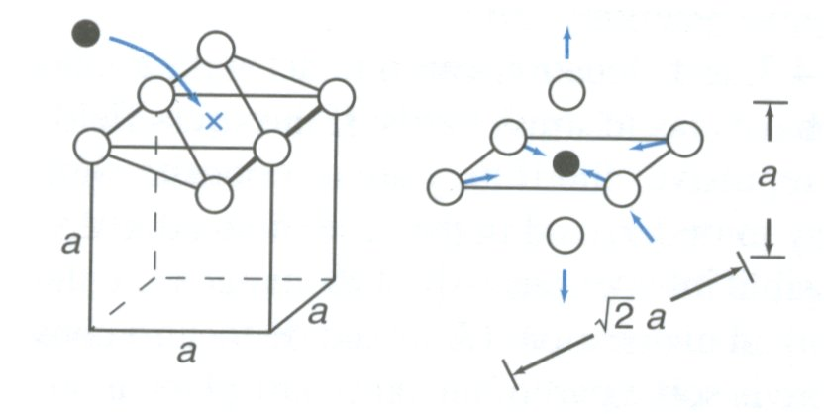
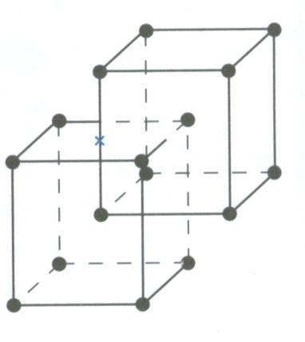
Octahedral Voids in BCC

Slide 7
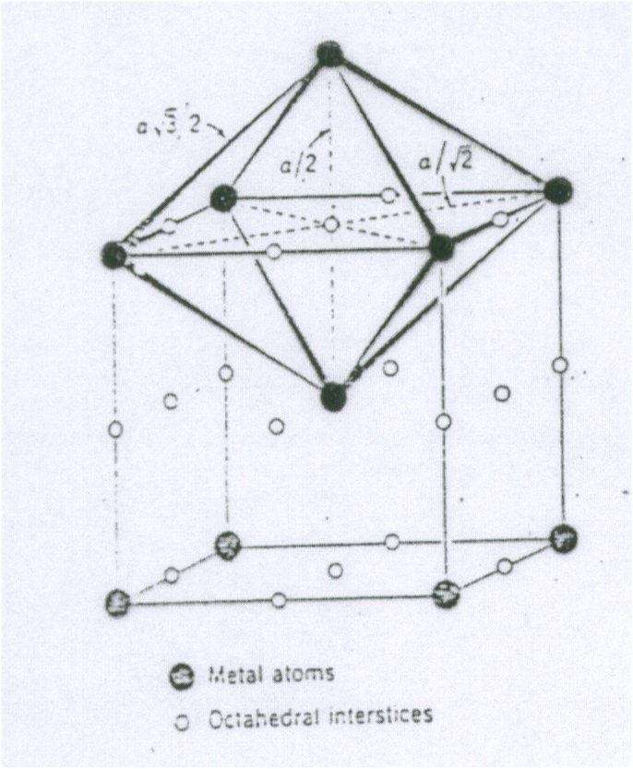
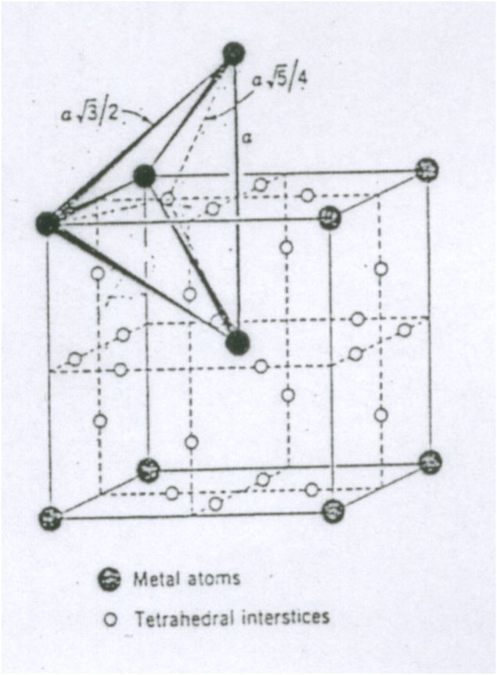
Voids in BCC

Slide 8
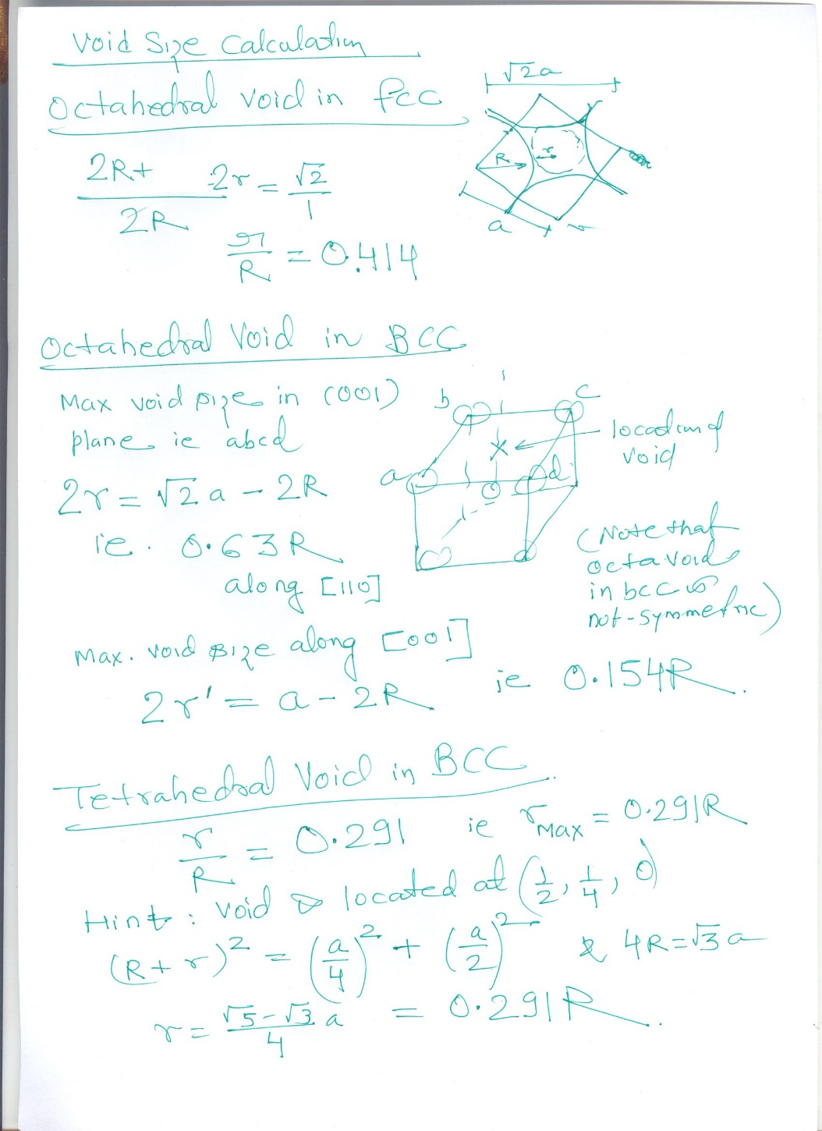
Illustration: Interstitial tetrahedral and octahedral void size calculation in a BCC crystal

Slide 9
Illustration: Interstitial tetrahedral and octahedral void size calculation in a FCC crystal

